Slide 1
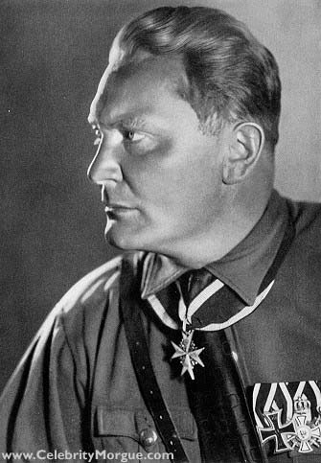
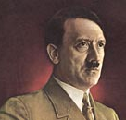
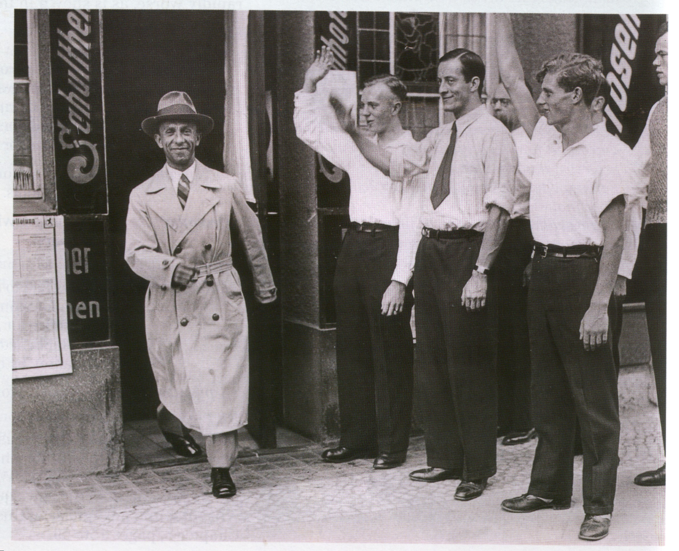
 starter activity
The ideal German:
as blond as Hitler,
as tall as Goebbels
and as slim as Goering
Hitler
Goering
Explain the joke. How useful is this source to historians studying Hitler’s Germany?
Goebbels

Slide 2
Nazi Anti-Semitism
L.O
Explain what the Nazi boycott of Jews meant for Jewish people
Explain what the Nuremberg Laws were.

Slide 3
Anti-Semitism
Jewish people are known as Semitics. So anti-Semitism means anti-Jewish.
Anti-Semitics are racists.
Jews were a minority in Germany in 1933.
Religious group
History of anti-Semitism in Europe, not just in Germany.
Stereotypes of Jews: criminals, sexual predators, inferior, bacteria, unpatriotic
Anti-Semitics believe Jews fit these stereotypes.

Slide 4
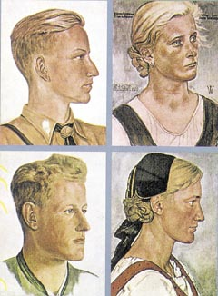
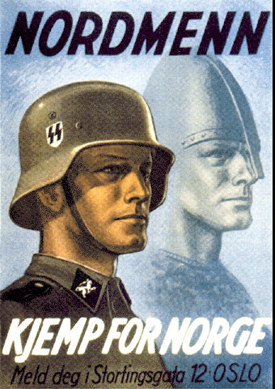
The Aryan Race
The Master Race.
History and Hitler’s interpretation.
Appearance.
The ‘ideal German’.

Slide 5
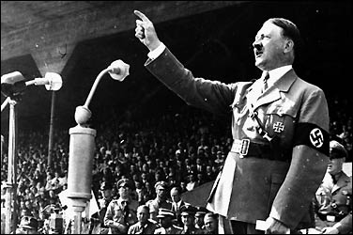
Hitler’s Anti-Semitism
Hitler’s personal hatred Jews
Treaty of Versailles
Fear of communism
“The aim of Jews is the complete destruction of the German ‘Reich’ and the spread of revolution.”

Slide 6
Nazi anti-Semitic measures
Anti-Semitism was central to Hitler’s idea of creating a new Germany
He didn’t want Jews to have any part to play in Nazi Germany.
When the Nazis came to power in 1933 they immediately began to put into place measures that would discriminate against Jews.

Slide 7
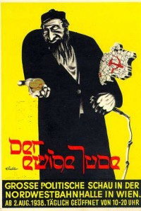
Anti-Semitic Propaganda

Slide 8
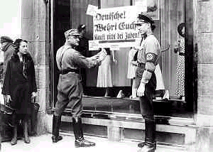
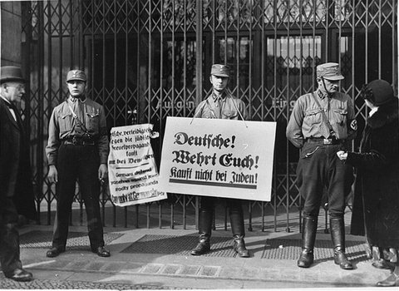
Boycott, 1933
People who went out shopping were encouraged not to buy any goods from Jewish shops
With the boycott the Nazis slowly began to make hatred of the Jews normal and acceptable. Over the coming years it would become expected of German people to be anti-Semitic.

Slide 9
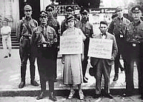
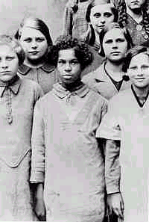
Nuremberg Laws, 1935
Following the Nuremburg laws, pictures were produced warning people about what could happen. People were degraded

Slide 10
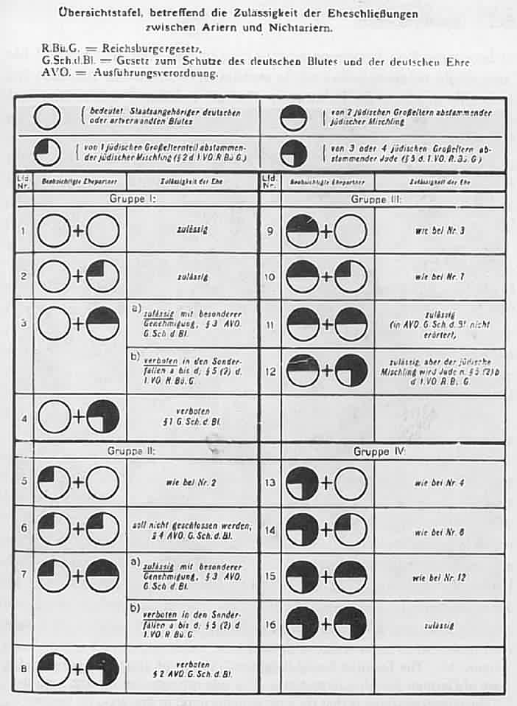
Jew
Pure German

Slide 11
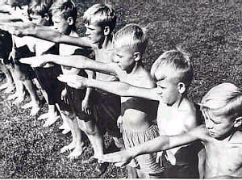
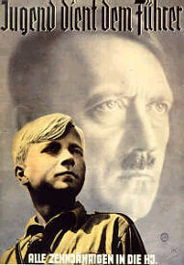
Anti-Semitism in Education
Posters encouraged children into recognising that Hitler was a saviour. Schools became places to pick on the Jews
Various efforts were made to ensure that the children were brought up to believe that the Jews were inferior and a danger to German people.

Slide 12
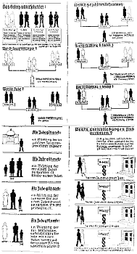
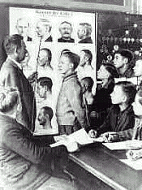
Two extracts from school books. The one on the left shows you the dangers of Jews and Germans marrying

Slide 13
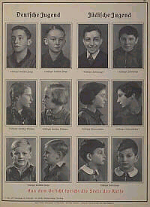
This book is designed to show what a normal German child looks like. The German child is on the left. The pictures on the right show what Jewish children look like

Slide 14
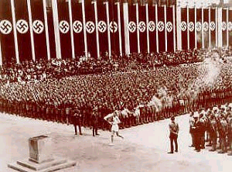
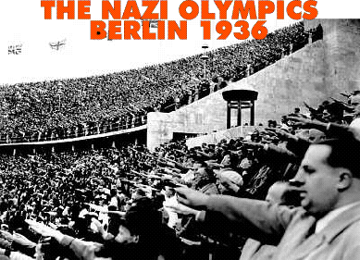
1936 Berlin Olympics
In 1936, the Olympic Games came to Germany.
The Nazis decided that they had to hide to the rest of the world what had been happening to the Jewish population.
They still wanted the rest of the world to know what they thought of their leader
Jesse Owens embarrassed Hitler.

Slide 15
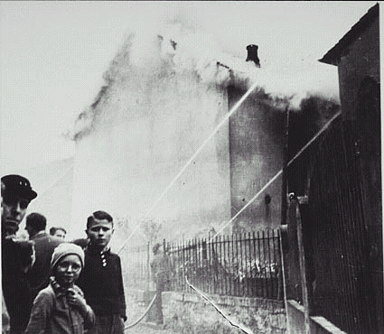
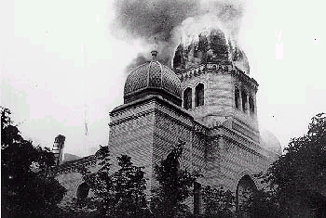
Kristallnacht, 1938
In 1938, the situation took a more serious turn for the worst. Called Kristallnacht or Night of Broken Glass, the Nazis start to use violence against the Jews.
Jewish shops, churches and other buildings were openly attacked. People became subjected to violence
It would lead to the start of more systematic violence...

Slide 16
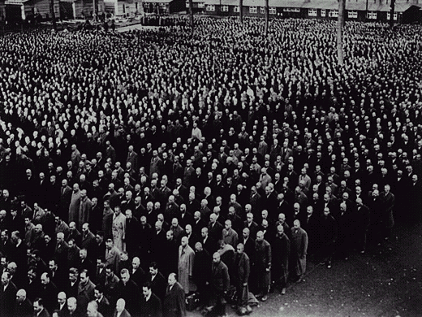
Ghettos, 1939 - 1945

Slide 17
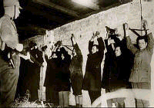
It is important to remember that it was not only the Jews who were to experience any form of prejudice within Germany. Other minority groups suffered too.
… communists, gypsies, homosexuals and other racial and religious groups also faced persecution.

Slide 18
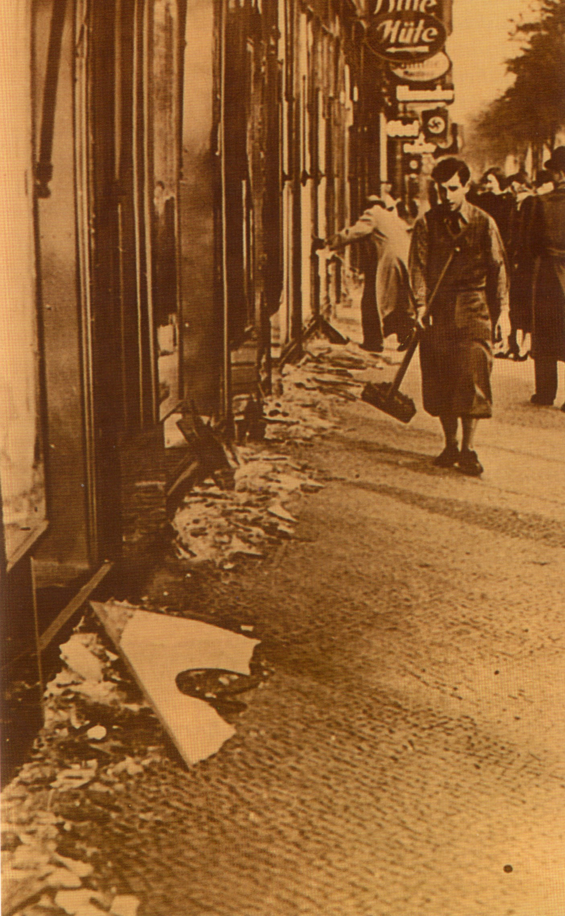
Anti-Semitism: Events summary
1933, Boycott- Jews excluded from civil service & education
1935, Nuremberg Laws
1938, Kristallnacht
1939, Jewish Ghettos
A Jewish shopkeeper clears up after the horrors of Kristallnacht

Slide 19
Group Task: Using the worksheet provided, and your own knowledge, complete the following tasks using full sentences. Everybody in the group should have very similar answers written down.
State what anti-Semitism is.
List at least four ways that the Nazis indoctrinated Germans into believing that Jews were inferior (they ‘normalised’ anti-Semitism). Think about the laws the Nazis passed and the propaganda that they used.
3) Draw two columns in your jotter, as below, detailing the effects of anti-Semitic policies on Jews and Germans citizens. I have completed two for you-add another three (at least) to each column. (six in total)
Effects of anti-Semitic policies on Jews
Made Jews feel inferior
Effects of anti-Semitic policies on German citizens
Germans stopped using Jewish shops
4) Create a mind map detailing the acceleration of anti-Semitism in Germany. The main areas you should focus on are: the 1933 Boycott; the 1935 Nuremberg Laws; 1938 Kristallnacht; propaganda; education; Hitler’s beliefs.

Slide 20
Task-Letter to the Editor
You are a Jewish writer living in Berlin in December 1938. You have been living in Germany since 1930 and have slowly seen things get worse for German Jews.
Write a letter to a British newspaper describing the ways in which life has become increasingly difficult and dangerous for German Jews since Hitler came to power.

